Slide 1
Random Numbers
Unit 5

Slide 2
Outline
Random Numbers and its properties,
Pseudo Random Numbers,
Methods of generation of Random Number,
Tests for Randomness - Uniformity and independence,
Random Variate Generation

Slide 3
Random Numbers and its properties
Random numbers are characterized by the fact that their value can not be predicted.
Random numbers are needed in many areas: cryptography, Monte Carlo computation and simulation, industrial testing and labeling, hazard games, gambling, etc.
In other words, if one constructs a sequence of random numbers, the probability distribution of the following random numbers have to be completely independent of all the other generated numbers.
Random numbers are samples drawn from a uniformly distributed random variable between some satisfied intervals, they have equal probability of occurrence.

Slide 4
Random Numbers and its properties
Random numbers are a necessary basic ingredient (element) in the simulation of almost all discrete systems.
Most computer languages have a subroutine, object, or function that will generate a random number.
Similarly simulation languages generate random numbers that are used to generate event limes and other random variables.
Random numbers must be unpredictable, statistically independent (unrelated to any previously generated random numbers), uniformly distributed (equal probability for any number to be generated) and protected
Notes:
Predictable random number generators (RNGs) open doors to many possible attacks that can hack devices and compromise data.

Slide 5
Random Numbers and its properties
Random numbers can be generated using a variety of methods, such as using a random number generator or by using a mathematical algorithm to produce a sequence of numbers that does not follow any recognizable pattern.
The numbers produced in this way are often used in statistical analysis, simulations, and other applications where the results need to be as unpredictable as possible.

Slide 6
Random Numbers and its properties
Properties of Random Numbers
A sequence of random numbers, 𝑅1, 𝑅2, 𝑅3 … .. must have two important properties:
Uniformity, i.e. they are equally probable every where
Independence, i.e. the current value of a random variable has no relation with the previous values

Slide 7
Random Numbers and its properties
General Properties of Random Numbers
Uniformity:
The random numbers generated should be uniform. That means a sequence of random numbers should be equally probable every where. equal probability for any number to be generated
If we divide all the set of random numbers into several numbers of class interval then number of samples in each class should be same.
If ‘N’ number of random numbers are divided into ‘K’ class interval, then expected number of samples in each class should be equal to N / K.

Slide 8
Random Numbers and its properties
General Properties of Random Numbers
Independent:
Each random number should be independent samples drawn from a continuous uniform distribution between 0 and 1 (given range).
unrelated to any previously generated random numbers

Slide 9
Random Numbers and its properties
General Properties of Random Numbers
Maximum Density:
The large samples of random number should be generated in a given range
Maximum Cycle:
It states that the repetition of numbers should be allowed only after a large interval of time.

Slide 10
Types of random numbers
There are several types of random numbers that can be generated, including:
True random numbers: These are numbers that are generated using a physical process, such as radioactive decay or atmospheric noise, to produce a truly random and unpredictable result.
Pseudorandom numbers: These are numbers that are generated using a deterministic algorithm, but are designed to have many of the statistical properties of truly random numbers. It is used to generate pseudorandom numbers.
Quasi-random numbers: These are numbers that are generated using a deterministic algorithm, but are designed to have many of the statistical properties of truly random numbers
Notes:
These different types of random numbers have different applications.

Slide 11
Random Numbers and its properties
1. True-Random Numbers
A hardware random number generator (HRNG) or true random number generator (TRNG) is a device that generates random numbers from a physical process, rather than by means of an algorithm.
True random numbers are gained from physical processes like radioactive decay (Radioactive decay is a process by which an unstable atomic nucleus emits particles and energy in order to become more stable) or also rolling a dice.
True random numbers are used for applications such as gaming, gambling, and in cryptography, where randomness is critically important.
Random numbers are best obtained using physical (true) random number generators (TRNG), which operate by measuring a well-controlled and specially prepared physical process. Randomness of a TRNG can be precisely, scientifically characterized and measured.
Notes:
.

Slide 12
Random Numbers and its properties
2. Pseudo Random Number
A set of values or elements that is statistically random, but it is derived from a known starting point and is typically repeated over and over.
It is called "pseudo" random, because the algorithm can repeat the sequence, and the numbers are thus not entirely random.
These numbers are generated by a computer or that is to say, by an algorithm and because of this not truly random.
Every new number is generated from the previous ones by an algorithm.
This means that the new value is fully determined by the previous ones. But, depending on the algorithm, they often have properties making them very suitable for simulations.

Slide 13
Random Numbers and its properties
3. Quasi Random Number
Quasirandom numbers generate each successive number as far away as possible from existing numbers in the set.
Quasirandom numbers are generally too uniform to pass randomness tests.
Pseudorandom numbers are less uniform than quasirandom numbers and may be more appropriate for applications that require greater randomness.
Quasi (Virtual) random numbers are not designed to appear random

Slide 14
Pseudo Random Numbers
A pseudorandom number generator (PRNG), also known as a deterministic random bit generator (DRBG), is an algorithm for generating a sequence of numbers whose properties approximate the properties of sequences of random numbers.
Pseudo means false, so false random numbers are being generated.
The goal of any generation scheme is to produce a sequence of numbers between zero and 1 which simulates, or imitates, the ideal properties of uniform distribution and independence as closely as possible.
Since the arithmetic operation is known and the sequence of random numbers can be repeated, the numbers cannot be called truly random number.
However, the pseudo-random numbers generated by many computer routines very closely fulfill the requirement of desired randomness.

Slide 15
Methods of generation of Random Number
Congruence or Residue Method (Uniform - Linear Congruential Method)
The linear congruential method, initially proposed by Lehrer [1951], produces a sequence of integers, X1, X2,... between zero and m-1 according to the following recursive relationship:
Xi+1 = (aXi + c) mod m.........................(i)
Where, X0 - initial value, is called the seed, a is called the constant multiplier, c is the increment, and m is the modulus.

Slide 16
Methods of generation of Random Number
Congruence or Residue Method (Uniform - Linear Congruential Method)
Case 1: If c ≠ 0 in Equation (i), the form is called the mixed congruential method.
Case 2: When c = 0 in Equation (i), the form is known as the multiplicative congruential method.
The selection of the values for a, c, m and Xo drastically affects the statistical properties and the cycle length.

Slide 17
Methods of generation of Random Number
Congruence or Residue Method (Uniform - Linear Congruential Method)
Example: For the values selection with X(0) = 30, a = 12, c = 21 and m = 100, the sequence of random numbers generated are as follows:
X(0) = 30
X(1) = (12 * 30 + 21) mod 100 =381 mod 100 = 81
X(2) = (12 * 81 + 21) mod 100 = 993 mod 100 = 93
X(3) = (12 * 93 + 21) mod 100 = 1137 mod 100 = 37 and so on…
The random numbers between [0, 1] generated are as follows:
R(0) = 0.3
R(1) = 0.81
R(2) = 0.93
R(3) = 0.37 and so on…….

Slide 18
Methods of generation of Random Number
Congruence or Residue Method (Uniform - Linear Congruential Method)
Mixed Congruential Method: c ≠ 0
Here ,
Xi+1 = (aXi + c) mod m
Let a = 9, c = 3 , m = 31 & X0 = 2
Then , X1 = (aX0 + c) mod m
= ( 9 X 2 + 3) mod 31 = 21 mod 31 = 21
X2 = (aX1 + c) mod m
= ( 9 X 21 + 3) mod 31
= 192 mod 31 = 6
And X3=26 , X4=20, X5=28
Hence, random number are 2,21,6,26,20,28,7,4,8

Slide 19
Methods of generation of Random Number
Congruence or Residue Method (Uniform - Linear Congruential Method)
Multiplicative Congruential Method: c = 0
Here ,
Xi+1 = (aXi ) mod m
Let a = 9 , m = 31 & X0 = 2
Then , X1 = (aX0 ) mod m
= ( 9 X 2) mod 31 = 18 mod 31 = 18
X2 = (aX1) mod m
= ( 9 X 18) mod 31 = 162 mod 31 = 7
And X3=1 , X4=9, X5=19
Hence, random number are 2,18,7,1,9,19,16,20.....

Slide 20
Methods of generation of Random Number
Congruence or Residue Method (Uniform - Linear Congruential Method)
Examples:
Let m = 100, a = 19, c = 0, and X0 = 63, and generate a sequence random integers. Find first 7 random number generate using any suitable method?
Use the linear congruential method to generate a sequence of random numbers with X 0 = 27, a= 17, c = 43, and m = 100.
Use the linear congruential method to generate a sequence of four-three digit random integers, with seed = 117, constant multiplier = 43 and modulus = 1000.
Use multiplicative congruential method to generate a sequence of three digits random numbers between (0, 1) with X = 27, c=25, a=3 and m =1000
Use the linear congruential method to generate a sequence of three two-digit random integers. Let X0 =29, a= 9, c=49, m=100
Use the multiplicative congruential method to generate five three digit random integers. X0 =118, a=45 and m = 1000

Slide 21
Lab 4
Use Excel or C or Matlab and generate 1000 random numbers
Examples:
Let m = 100, a = 19, c = 0, and X0 = 63, and generate a sequence random integers.
Use the linear congruential method to generate a 1000 sequence of random numbers with X 0 = 27, a= 17, c = 43, and m = 100.
Use the Multiplicative congruential method to generate a 1000 sequence random integers, with seed = 117, constant multiplier = 43 and modulus = 1000.
Use multiplicative congruential method to generate a 1000 sequence of random numbers between (0, 1) with X = 27, a=3 and m =1000.
Use the linear congruential method to generate a 1000 sequence random integers. Let X0 =29, a= 9, c=49, m=100
Use the multiplicative congruential method to generate 1000 random integers. X0 =118, a=45 and m = 1000

Slide 22
Methods of generation of Random Number
Mid square method:
This method was proposed by Van Neumann.
In this method, we have a seed and then the seed is squared and its midterm is fetched as the random number.
Consider we have a seed having N digits we square that number to get a 2N digits number if it doesn’t become 2N digits we add zeros before the number to make it 2N digits.

Slide 23
Methods of generation of Random Number
Mid square method:
Start with n digit number
Square it
For 8 digit : Remove two lower and higher order digit
For 7 digit: Remove one lower and two higher order digit
Taking n digits in the middle as the next number
Repeat from number 2

Slide 24
Methods of generation of Random Number
Mid square method:
For example, we are using 4 digit, we are generating 5 random numbers here
(5673)² = 32182929 =1829 (next seed number)
(1829)² = 03325241 = 3452
(3452)² = 11916304 = 9163
(9163)² = 83960569 = 9605
(9605)² = 92256025 = 2560

Slide 25
Methods of generation of Random Number
Mid square method:
Example: Consider the seed to be 14 and we want a two digit random number.
Number --> Square --> Mid-term
14 --> 0196 --> 19
19 --> 0361 --> 36
36 --> 1296 --> 29
29 --> 0841 --> 84
84 --> 7056 --> 05
05 --> 0025 --> 02
02 --> 0004 --> 00
00 --> 0000 --> 00

Slide 26
Methods of generation of Random Number
Homework:
Use Multiplicative congruential method to generate a sequence of 10 three-digit random integers and corresponding random variables. Let X0 =4, a=3 and c=2 m=1000
Use the mixed congruential method to generate a sequence of three two-digit random numbers with x0=37, a=7, c=29 and m =100
Use the multiplicative congruential method to generate a sequence of four three-digit random numbers. Let X0 =118, a=4, c=5 and m =100

Slide 27
Tests for Randomness - Uniformity and independence
Testing for Randomness :
The desirable properties of random numbers — uniformity and independence to ensure that these desirable properties are achieved, a number of tests can be performed.
The tests can be placed in two categories according to the properties of interest.
Testing for uniformity
Testing for independence.

Slide 28
Tests for Randomness - Uniformity and independence
There are different types of test:
Frequency test: Uses the Kolmogorov-Smirnov (KS) or Chi-square test to compare the distribution of the set of numbers generated to a uniform distribution
Runs test: Tests the runs up and down or the runs above or below the mean by comparing the actual value to expected value. The statistics for comparison in Chi-square.
Auto correlation test: Tests the correlation between numbers and compares the sample correlation to the expected correlation of zero.
Gap test: Counts the number of digits that appear between repetition of a particular digit and then uses KS test to compare with the expected size of gaps.
Poker test: Treats numbers group together as a poker hand. Then the hands obtained are compared to what is expected using the Chi-square test.

Slide 29
Tests for Randomness - Uniformity and independence
Testing for uniformity :The Kolmogorov-Smirnov (KS) test
The Kolmogorov-Smirnov Goodness of Fit Test (K-S test) compares your data with a known distribution and lets you know if they have the same distribution.
Although the test is nonparametric — it doesn’t assume any particular underlying distribution — it is commonly used as a test for normality to see if your data is normally distributed.
It’s also used to check the assumption of normality in Analysis of Variance.
It is used to decide if a sample comes from a population with a specific distribution.
More specifically, the test compares a known hypothetical probability distribution (e.g. the normal distribution) to the distribution generated by your data — the empirical distribution function.

Slide 30
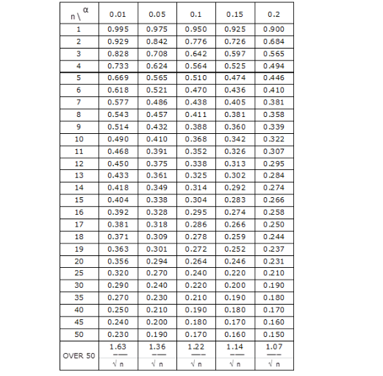
Tests for Randomness - Uniformity and independence
Testing for uniformity : Table A.8 Kolmogorov-Smirnov Critical Values

Slide 31
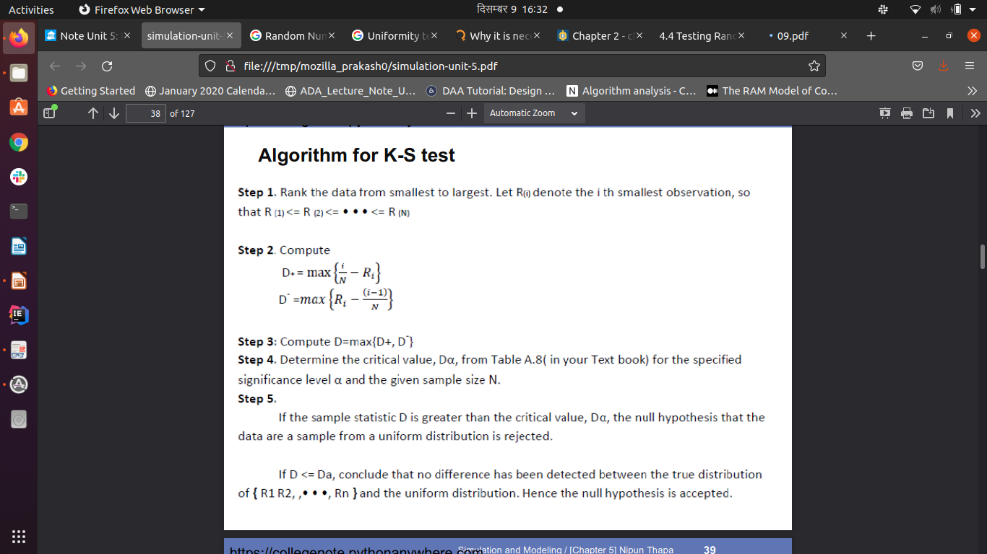
Tests for Randomness - Uniformity and independence
Testing for uniformity :The Kolmogorov-Smirnov (KS) test

Slide 32
Tests for Randomness - Uniformity and independence
Testing for uniformity :The Kolmogorov-Smirnov (KS) test
Example : Suppose that the five numbers 0.44 , 0.81, 0.14, 0.05, 0.93 were generated, and it is desired to perform a test for uniformity using the Kolmogorov-Smirnov test with a level of significance a of 0.05.
Solution,
First, the numbers must be ranked from smallest to largest
i.e. 0.05 , 0.14 , 0.44 , 0.81 , 0.93
Then, The computations for
D+, namely { i /N -R(i) } and for
D-, namely { R(i ) - ( i - 1 ) / N } ,

Slide 33
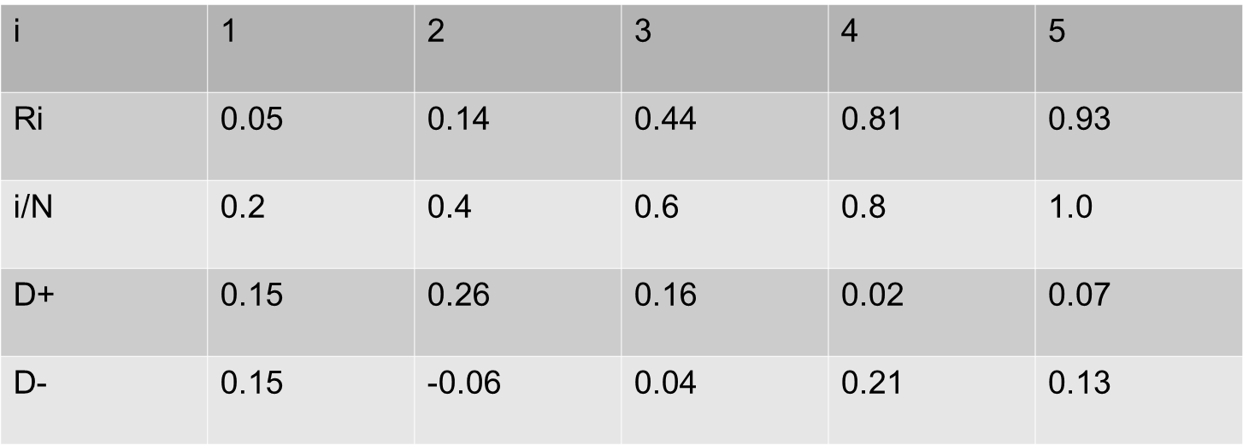
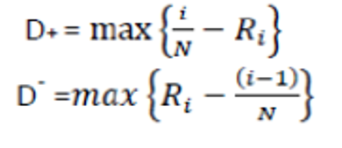
Tests for Randomness - Uniformity and independence
Example Continue
0.05
The statistics are computed as D+ = 0.26 and D- = 0.21.
Therefore, D = max{0.26, 0.21} = 0.26

Slide 34
Tests for Randomness - Uniformity and independence
Testing for uniformity : Kolmogorov-Smirnov Test: EXAMPLE
Then, The critical value of D, obtained from Table for a = 0.05 and N= 5, is 0.565.
Since the computed value, 0.26, is less than the tabulated critical value, 0.565, the hypothesis of no difference between the distribution of the generated numbers and the uniform distribution is not rejected.

Slide 35
Tests for Randomness - Uniformity and independence
Testing for uniformity : Kolmogorov-Smirnov Test: EXAMPLE
Suppose that the five numbers 0.24 , 0.80, 0.11, 0.05, 0.93 were generated, and it is desired to perform a test for uniformity using the Kolmogorov-Smirnov test with a level of significance a of 0.01.
Suppose that the four numbers 0.80, 0.14, 0.05, 0.5 were generated, and it is desired to perform a test for uniformity using the Kolmogorov-Smirnov test with a level of significance a of 0.10.
Suppose that the seven numbers 0.44 , 0.81, 0.14, 0.05, 0.93, 0.01, 0.02 were generated, and it is desired to perform a test for uniformity using the Kolmogorov-Smirnov test with a level of significance a of 0.05.
The sequence of numbers 0.37, 0.29, 0.19, 0.88 0.44, 0.63, 0.77, 0.70 0.21, and 0.58 has been generated. Use K-S test to determine if the numbers are uniformly distributed (Dα = 0.41 for α = 0.05
The sequence of numbers 0.54, 0.73, 0.98, 0.11 and 0.68 has been generated. Use the Kolmogorov-Smirnov test to determine if the hypothesis that the numbers are uniformly distributed on the interval 0 to 1 can be rejected. (Note that the critical value of D for for a=0.05 and N=5 is 0.565)

Slide 36
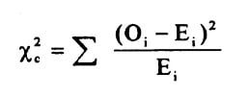
Tests for Randomness - Uniformity and independence
Testing for uniformity : The Chi-square Test
A chi-square test compares two variables in a contingency table to see if they are related. In a more general sense, it tests to see whether distributions of categorical variables differ from each another
The subscript “c” is the degrees of freedom. “O” is your observed value and E is your expected value.
It’s very rare that you’ll want to actually use this formula to find a critical chi-square value by hand.

Slide 37
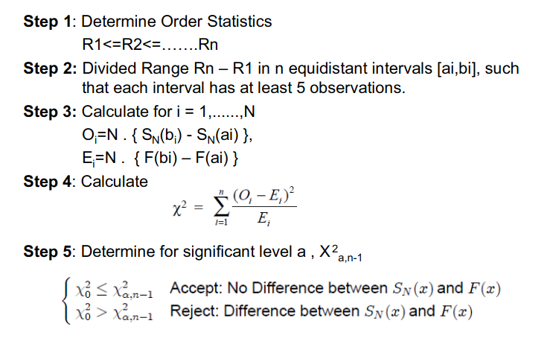
Tests for Randomness - Uniformity and independence
Testing for uniformity : The Chi-square Test

Slide 38
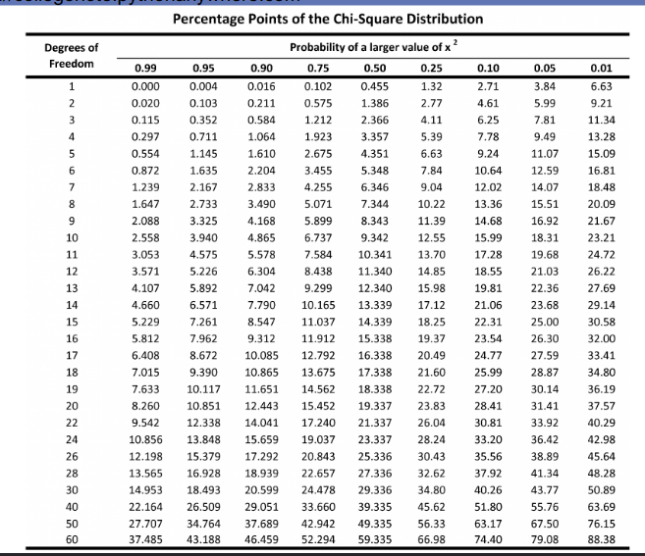
Tests for Randomness - Uniformity and independence
Testing for uniformity : The Chi-square Test

Slide 39
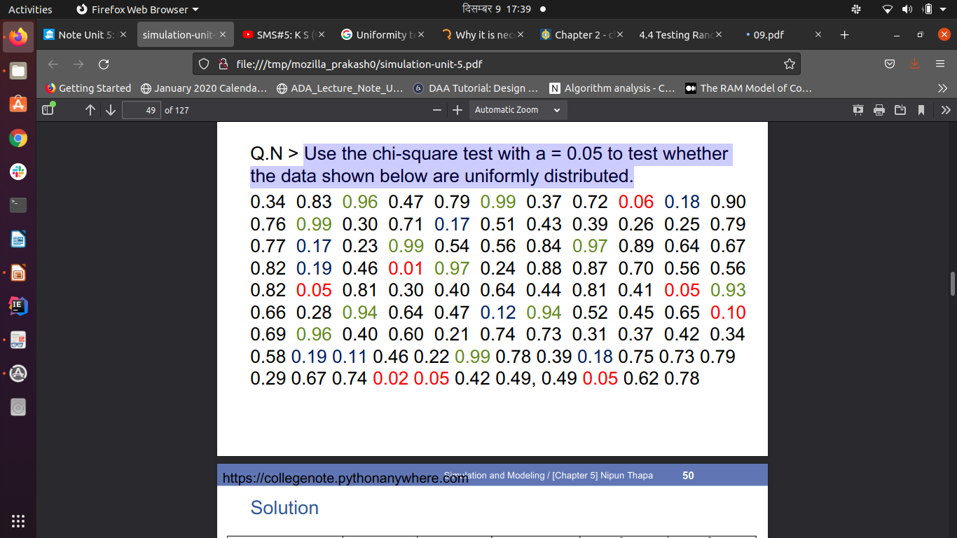
Tests for Randomness - Uniformity and independence
Testing for uniformity : The Chi-square Test
Use the chi-square test with a = 0.05 to test whether the data shown below are uniformly distributed.

Slide 40
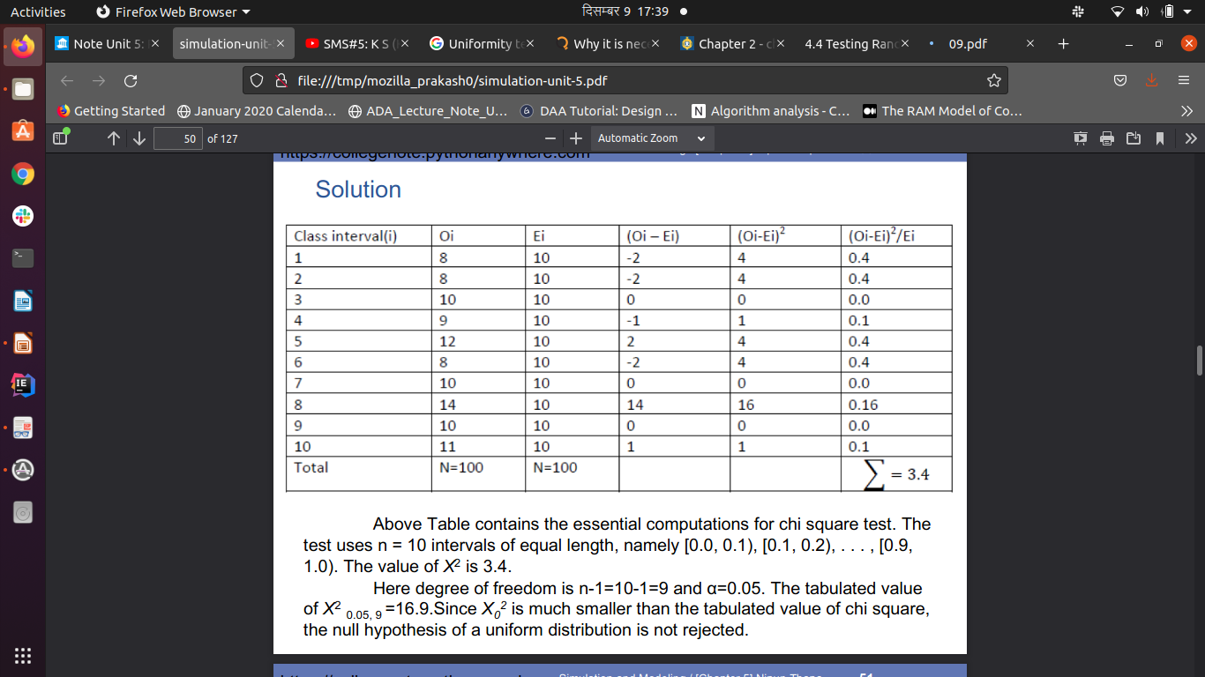
Tests for Randomness - Uniformity and independence
Testing for uniformity : The Chi-square Test
Solution

Slide 41
Tests for Randomness - Uniformity and independence
Testing for uniformity : The Chi-square Test
Solution

Slide 42
Tests for Randomness - Uniformity and independence
Testing for uniformity : The Chi-square Test
Use the chi-square test with a = 0.05 to test whether the data shown below are uniformly distributed In first ranges there are 15 random number , in second there are 5 random number, in 3rd there are 10 random number, in fourth there are 10 and in 5th there are 20 random number.
Use the chi-square test with a = 0.99 to test whether the data shown below are uniformly distributed In first ranges there are 10 random number , in second there are 10 random number, in 3rd there are 15 random number, in fourth there are 15 , in 5th there are 5 random number. And then 6th ,7th and 8th has 10 , 5 , 10 random numbers.
Use the chi-square test with a = 0.25 to test whether the data shown below are uniformly distributed In first ranges there are 20 random number , in second there are 9 random number, in 3rd there are 15 random number, in fourth there are 15 and in 5th there are 16 random number.

Slide 43
Tests for Randomness - Uniformity and independence
Testing for uniformity :
Both the Kolmogorov-Smirnov and the chi-square test are acceptable for testing the uniformity of a sample of data, provided that the sample size is large. However, the Kolmogorov-Smirnov test is the more powerful of the two and is recommended. Furthermore, the Kolmogorov-Smirnov test can be applied to small sample sizes, whereas the chi-square is valid only for large samples, say N>=50.

Slide 44
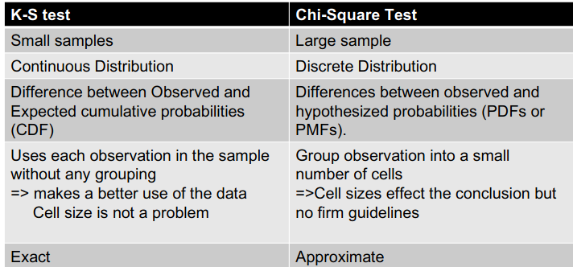
Tests for Randomness - Uniformity and independence
Testing for uniformity : Chi-Square Vs. K-S Test

Slide 45
Tests for Randomness - Uniformity and independence
Use multiplicative congruential method to generate a sequence of three digits random numbers between (0, 1) with X = 27, a=3, c=5 and m =1000. use any one of the uniformity test to find out whether the generated numbers are uniformly distributed or not?(critical value for alpha=0.05 and N=5 is 0.565) [10 marks]

Slide 46
Tests for Randomness - Uniformity and independence
Independent test determines whether a random number generator is producing independent random number in a sequence. Test for independence includes the three types of tests as given below:
Auto correlation test: Tests the correlation between numbers and compares the sample correlation to the expected correlation of zero.
Gap test: Counts the number of digits that appear between repetition of a particular digit and then uses KS test to compare with the expected size of gaps.
Poker test: Treats numbers group together as a poker hand. Then the hands obtained are compared to what is expected using the Chi-square test.

Slide 47
Tests for Randomness - Uniformity and independence
Test for independence :Tests for Autocorrelation
Autocorrelation Test is a statistical test that determines whether a random number generator is producing independent random number in a sequence.
The tests for autocorrelation are concerned with the dependence between numbers in a sequence.
The test computes the autocorrelation between every m numbers (m is also known as the lag) starting with the i number (i is also known as the index).
Important Variables
m - is the lag, the space between the numbers being tested. i - is the index, or the number in the sequence that you start with N - the number of numbers generated in a sequence M - is the largest integer such that i + (M + 1)m <= N

Slide 48
Tests for Randomness - Uniformity and independence
Test for independence :Tests for Autocorrelation
The test described below requires the computation of the autocorrelation between every m numbers (m is the lag) starting with the ith number. The autocorrelation ρ_{im} between the following numbers . R_{i,}R_{i+m,} R_{i+2m,………} R_{i+(M+1)m,}
The value M is the largest integer such that i + (M + 1)m <= N, where N is the total numbers in the sequence.
Now The autocorrelation ρ_{im} between the following numbers . R_{i,}R_{i+m,} R_{i+2m,………} R_{i+(M+1)m} is computed as

Slide 49
Tests for Randomness - Uniformity and independence
Test for independence :Tests for Autocorrelation
Then the test statistic can be formed as follows
Where the standard deviation is
After computing Zo, don’t reject the null hypothesis of independence if –Za/2 <= Zo <= Za/2, where a is the level of significance.

Slide 50
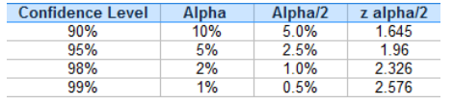
Tests for Randomness - Uniformity and independence
You don’t actually have to look up z alpha/2 in a z-table every time. For most hypothesis tests, you’ll probably be using one of four confidence levels (90%, 95%, 98% and 99%). The z alpha/2 for each confidence level is always the same:

Slide 51
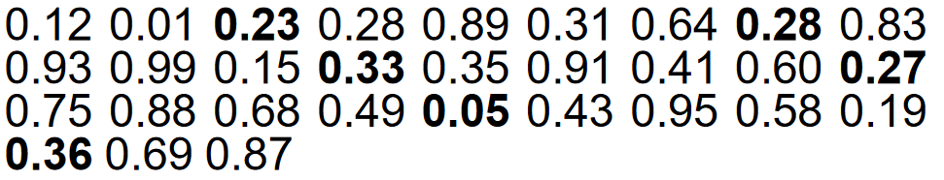
Tests for Randomness - Uniformity and independence
Test for independence :Tests for Autocorrelation
Test whether the 3rd, 8th, 13th, and so on, numbers in the sequence at the beginning of this section are auto-correlated. (Use a = 0.05.)
Here, i = 3 (beginning with the third number), m =5 (every five numbers), N = 30 (30 numbers in the sequence).

Slide 52
Tests for Randomness - Uniformity and independence
Test for independence :Tests for Autocorrelation
Test whether the 3rd, 8th, 13th, and so on, numbers in the sequence at the beginning of this section are auto-correlated. (Use a = 0.05.)
Solution: First we calculate the value of M using the condition
i + (M+1)m<=N
since i=3, m=5, and N=30, we have,
3 + (M +1)5 <= 30.
i.e. 3+5M+5<=30
I.e. 5M<=22
i.e. M<=22/5
Hence M=4

Slide 53
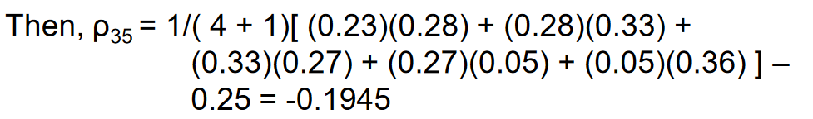
Tests for Randomness - Uniformity and independence
Test for independence :Tests for Autocorrelation
And

Slide 54
Tests for Randomness - Uniformity and independence
Test for independence :Tests for Autocorrelation
Then, the test statistic assumes the value Z0 = -0.1945/0.1280 = -1.516
Now, the critical value is Z0.025 = 1.96 (Zα/2 is taken in this test)
–Za/2 <= Zo <= Za/2
–1.96 <= -1.516 <= 1.96 Therefore, the hypothesis of independence cannot be rejected on the basis of this test

Slide 55
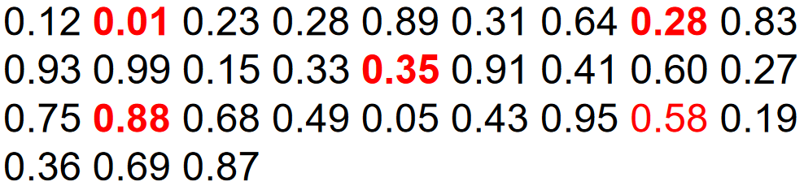
Tests for Randomness - Uniformity and independence
Test for independence :Tests for Autocorrelation
Exercise : Test whether the 2nd, 8th, 14th, and so on, numbers in the sequence at the beginning of this section are auto-correlated. (Use a = 0.05.)
Notes:
Here, i = 2 (beginning with the second number), m = 6 (every six numbers), N = 30 (30 numbers in the sequence).

Slide 56
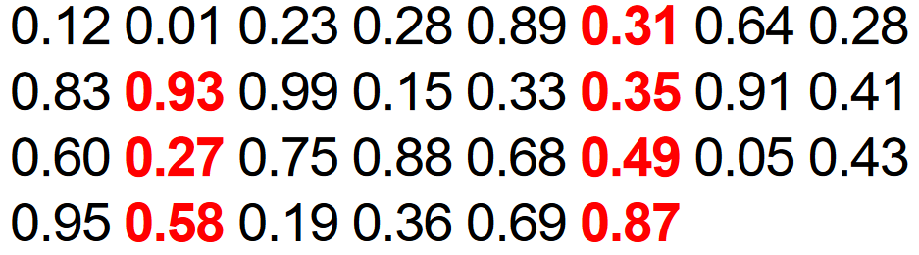
Tests for Randomness - Uniformity and independence
Test for independence :Tests for Autocorrelation
Exercise : Test whether the 6th, 10th, 14th, and so on, numbers in the sequence at the beginning of this section are auto-correlated. (Use a = 0.05.)
Notes:
Here, i = 6 (beginning with the fifth number), m = 4 (every five numbers), N = 30 (30 numbers in the sequence).

Slide 57
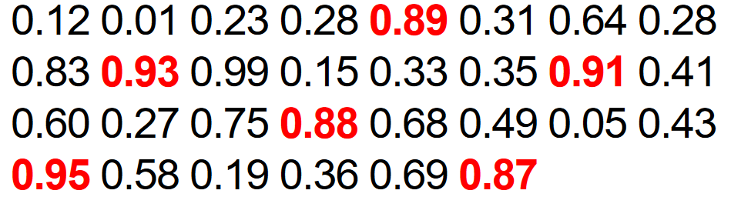
Tests for Randomness - Uniformity and independence
Test for independence :Tests for Autocorrelation
Exercise : Test whether the 5th, 10th, 15th, and so on, numbers in the sequence at the beginning of this section are auto-correlated. (Use a = 0.05.)
Notes:
Here, i = 5 (beginning with the fifth number), m = 5 (every five numbers), N = 30 (30 numbers in the sequence).

Slide 58
Tests for Randomness - Uniformity and independence
Test for independence :Poker Test
This test gets its name from a game of cards called poker
The Poker Test is the test for independence based on the frequency with which certain digits are repeated with in a series of numbers.
This test not only tests for the randomness of the sequence of numbers, but also the digits comprising of each of the numbers.
The poker test uses the chi square statistics to accept or reject the null hypothesis.

Slide 59
Tests for Randomness - Uniformity and independence
Test for independence :Poker Test
The expected value of each of the combination of digits in a number is compared with the observed value by means of the chi-square test for independence.
The acceptance is done if the observed value of chi-square sums for all the possible combinations of digits is less than the acceptable value for the given degree of freedom at the specified confidence interval.

Slide 60
Tests for Randomness - Uniformity and independence
Step 1: Calculate all the probabilities
Step 2: Calculate expected frequency (probability of occurrence X Sample number)
Step 3: Find X2 using Chi-Square test
Step 4: Determine Significant level a,

Slide 61
Tests for Randomness - Uniformity and independence
Test for independence :Poker Test
For three digits: three possibilities
All different
All equal
One pair of like digits
P(three different digits)
P(second different from first) P(third different from first and second)
(0.9)(0.8) = 0.72
P(three like digits)
P(second digit same as first) P(third digit same as first and second)
(0.1)(0.1) = 0.01
P(exactly one pair) = 1 - 0.72 - 0.01 = 0.27

Slide 62
Tests for Randomness - Uniformity and independence
Test for independence :Poker Test
For four digits: five possibilities
All different
All equal
One pair of like digits
Two pairs
Three of same kinds

Slide 63
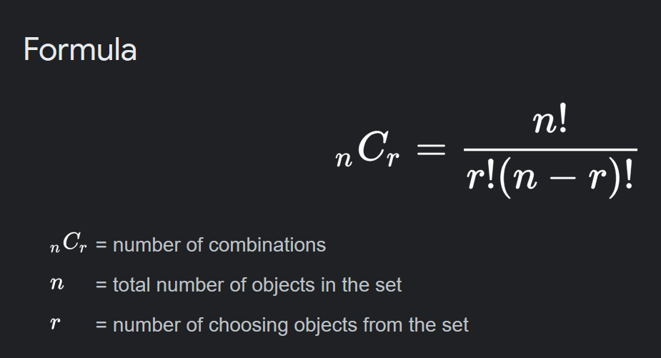
Tests for Randomness - Uniformity and independence
Test for independence :Poker Test
P(four different digits)
= 4C4 x 10/10 x 9/10 x 8/10 x 7/10 = 0.504
P (one pair)
= 4C2 x10/10x1/10x9/10x8/10=0.432
P (two pair)
= 4C2/2 x 10/10 x 1/10 x 9/10 x 1/10 = 0.027
P (three digits of a kind)
= 4C3 x 10/10 x 1/10 x 1/10 x 9/10 = 0.036
P (four digits of a kind)
= 4C4 x 10/10 x 1/10 x 1/10 x 1/10 = 0.001

Slide 64
Tests for Randomness - Uniformity and independence
Test for independence :Poker Test
71549 are five different digits
55137 would be pair (5C2)
33669 would be two pairs ((5C2)/2) * 3C2
55513 would be three of a kind 5C3
44477 would be a full house 5C2
77774 would be four of a kind 5C4
88888 would be five of a kind 5C5
The occurrence of five of a kind is rare.

Slide 65
Tests for Randomness - Uniformity and independence
Test for independence :Poker Test
P(five different digits) = 5C5 * 1 * 0.9 * 0.8 * 0.7 * 0.6 = 0.3024
P (one pair and three different) = 5C2 * 1 * 0.1 * 0.9 * 0.8 * 0.7 = 0.5040
P (two pair) = (5C2 )/2 * 3C2 * 1 * 0.1 * 0.9 * 0.1 * 0.8 = 0.108
P (three digits of a kind) = 5C3 * 1 * 0.1 * 0.1 * 0.9 * 0.8= 0.072
P (full house) = 5C2 * 1 * 0.1 * 0.1 *0.9 * 0.1= 0.009
P (four of a kind) = 5C4 * 1 * 0.1 * 0.1 * 0.1 * 0.9 = 0.0045
P (five of a kind) = 5C5 * 1 * 0.1 * 0.1 * 0.1 * 0.1 = 0.0001

Slide 66
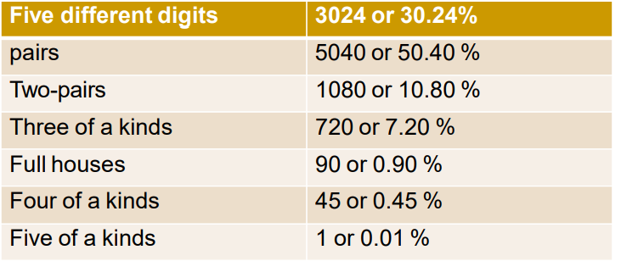
Tests for Randomness - Uniformity and independence
Test for independence :Poker Test
In 10,000 random and independent numbers of five digits each, you may be expect the following distribution of various combinations.

Slide 67
Tests for Randomness - Uniformity and independence
Test for independence :Poker Test
Example 1 : A sequence of 1000 three-digit numbers has been generated and an analysis indicates that 680 have three different digits, 289 contain exactly one pair of like digits, and 31 contain three like digits. Based on the poker test, are these numbers independent ? Let α = 0.05. Test these numbers using poker test for three digits.

Slide 68
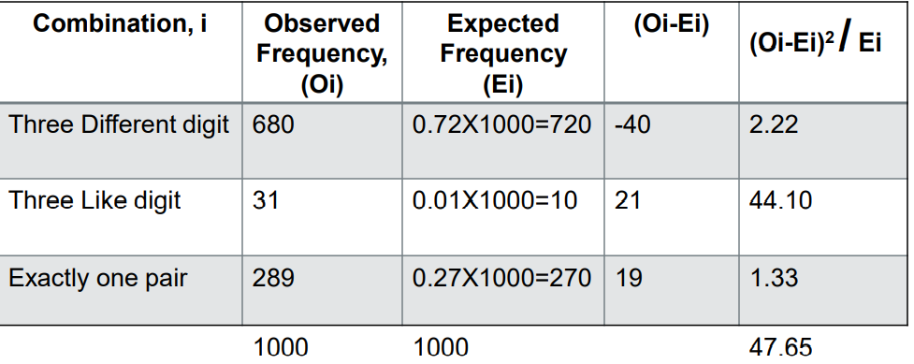
Tests for Randomness - Uniformity and independence
Test for independence :Poker Test
Solution of Example 1 :
Since 47.65 > X2 0.05,2 = 5.99 (tabulated value), the independence of the numbers is rejected on the basis of this test.

Slide 69
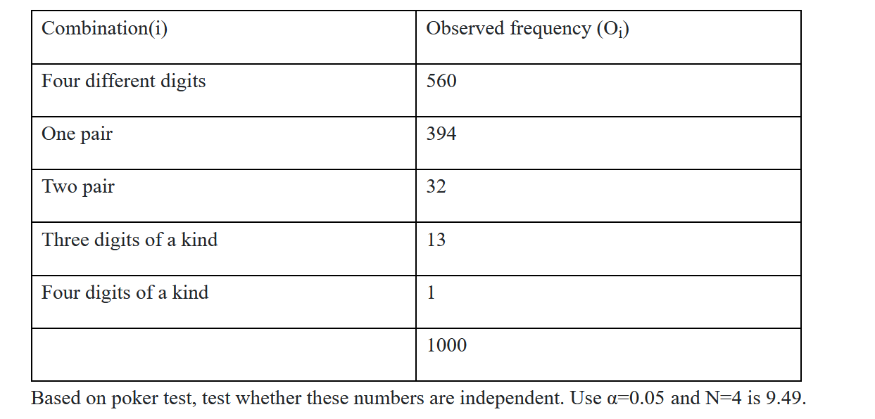
Tests for Randomness - Uniformity and independence
Test for independence :Poker Test
Example 2 : A sequence of 1000 four digit numbers has been generated and an analysis indicates the following combinations and frequencies.

Slide 70
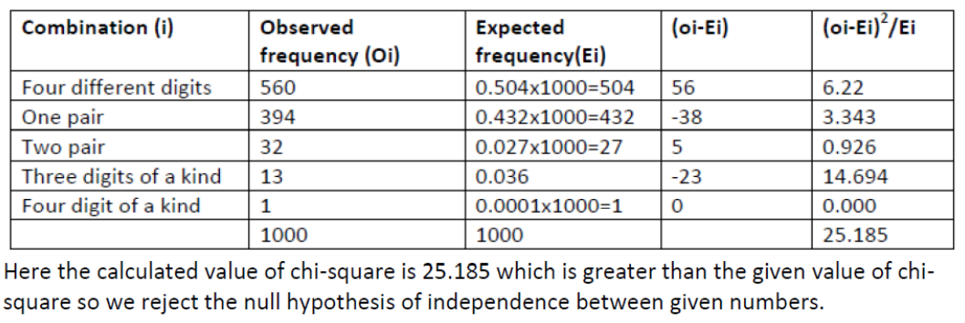
Tests for Randomness - Uniformity and independence
Test for independence :Poker Test - Solution of Example 2 :

Slide 71
Tests for Randomness - Uniformity and independence
Test for independence :Poker Test – Questions
1. Define and develop a Poker test for four-digit random numbers. A sequence of 10,000 random numbers, each of four digits has been generated. The analysis of the numbers reveals that in 5120 numbers all four digits are different, 4230 contain exactly one pair of like digits, 560 contain two pairs, 75 have three digits of a kind and 15 contain all like digits. Use Poker test to determine whether these numbers are independent. (Critical value of chi-square test for a = 0.05 and N=4 is 9.49)
2. A sequence of three-digit numbers has been generated and an analysis indicates that 300 have three different digits, 500 contain exactly one pair of like digits, and 200 contain three like digits. Based on the poker test, are these numbers independent ? Let α = 0.05. Test these numbers using poker test for three digits.

Slide 72
Tests for Randomness - Uniformity and independence
Test for independence :Poker Test – Questions
4. A sequence of three-digit numbers has been generated and an analysis indicates that 380 have three different digits, 389 contain exactly one pair of like digits, and 231 contain three like digits. Based on the poker test, are these numbers independent ? Let α = 0.05. Test these numbers using poker test for three digits.
5. A sequence of three-digit numbers has been generated and an analysis indicates that 320 have three different digits, 420 contain exactly one pair of like digits, and 160 contain three like digits. Based on the poker test, are these numbers independent ? Let α = 0.05. Test these numbers using poker test for three digits.

Slide 73
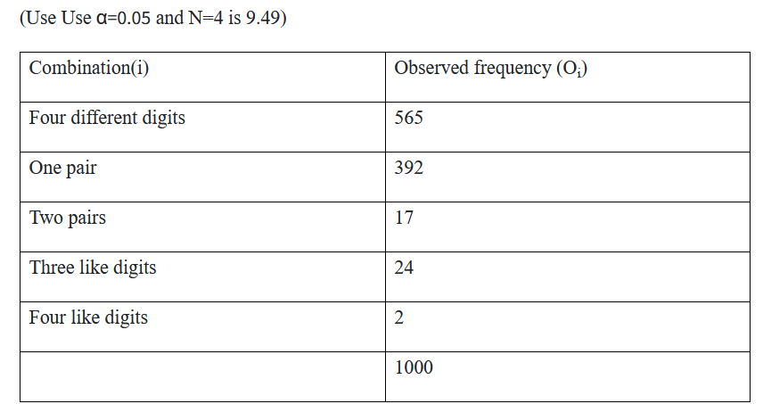
Tests for Randomness - Uniformity and independence
Test for independence :Poker Test – Questions
6. Develop the Poker test for four digit numbers, and use it to test whether a sequence of following 1000-four digit numbers are independent.

Slide 74
Tests for Randomness - Uniformity and independence
Test for independence :Gap Test
The gap test is used to determine the significance of the interval between the recurrences of the same digit. A gap of length x occurs between the recurrences of some specified digit.
The gap test is a statistical test for independence that can be used to determine whether there is a relationship between two categorical variables.
It Counts the number of digits that appear between repetitions of a particular digit and then uses the Kolmogorov-Smirnov test to compare with the expected number of gaps.

Slide 75
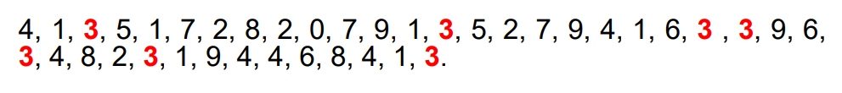
Tests for Randomness - Uniformity and independence
Test for independence :Gap Test
A gap of length x occurs between the recurrences of some specified digit. The following example illustrates the length of gaps associated with the digit 3:
There are 7 three’s are there. Thus only six gaps can occur. The first gap is of length 10 and second gap of length 7 and third gap of length zero. And so on. Similarly the gap associated with other digits can be calculated. The theoretical probability of first gap (of length 10 for digit 3) can be calculated as

Slide 76
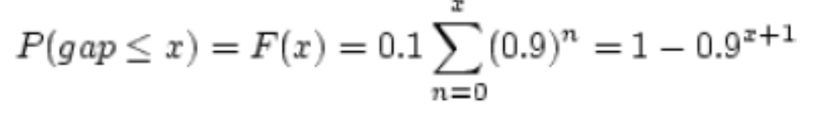
Tests for Randomness - Uniformity and independence
Test for independence :Gap Test
The theoretical frequency distribution for randomly ordered digits is given by

Slide 77
Tests for Randomness - Uniformity and independence
Test for independence :Gap Test
1. Specify the CDF (Cumulative Distributive frequency) from theoretical frequency distribution given by,
𝐹(x) = 1 − 0.9^{x+1} Based on the selected class interval
2. Arrange the observed sample of gaps in cumulative distribution with the same class
3. Find 𝐷, the maximum deviation between 𝐹(𝑥) and 𝑆𝑁(𝑥) as equation, 𝐷= | 𝐹(𝑥) − 𝑆𝑁(𝑥) |
4. Determine the critical value of 𝐷𝛼 from the table for the specified value of α and sample size 𝑁. (KS table)
5. If 𝐷𝑐𝑎𝑙 < 𝐷𝛼 , Null hypothesis is not rejected.

Slide 78
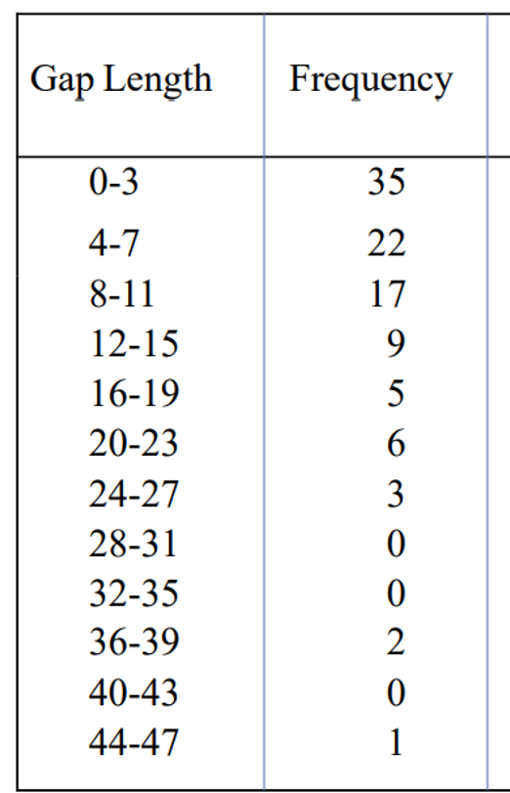
Tests for Randomness - Uniformity and independence
Test for independence :Gap Test
Q.N->Based on the frequency with which gaps occur, analyze the 100 digits below to test whether they are independent. Use α = 0.05.

Slide 79
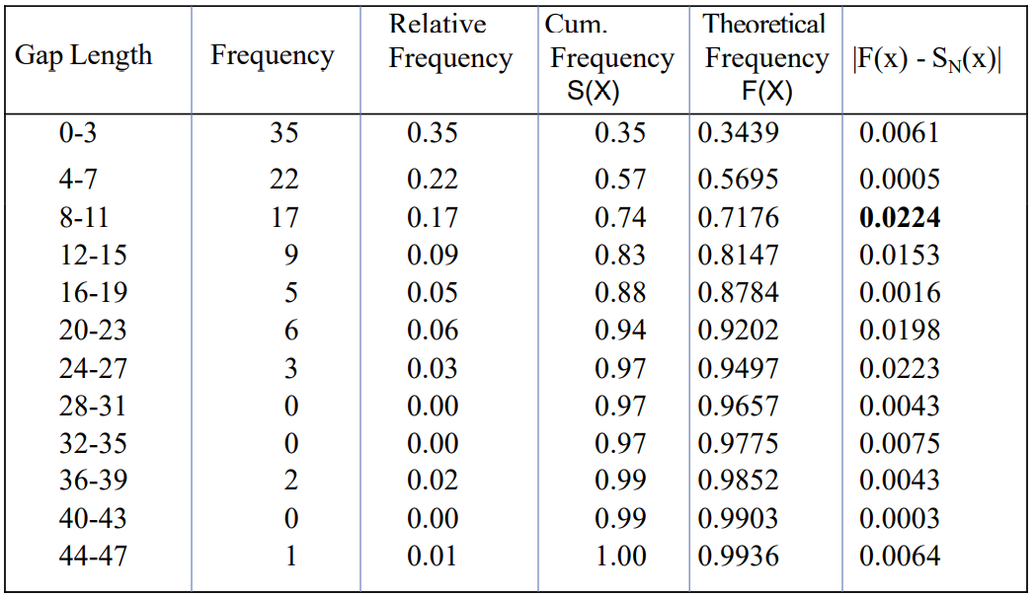
Tests for Randomness - Uniformity and independence
Test for independence :Gap Test - Solution
Since
D = max |F(x) - SN(x) | = 0.0224
The critical value of D is given by
D0.05 = 1.36 / √100 = 0.136
we do not reject the hypothesis
of independence on the basis
of this test.
Notes:
X = gap length last number

Slide 80
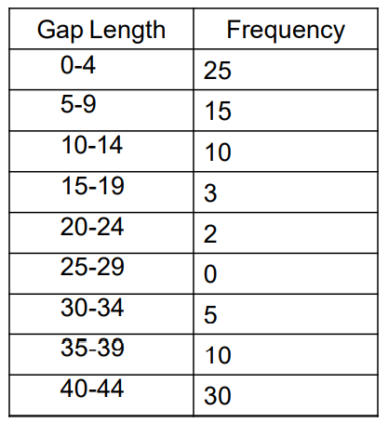
Tests for Randomness - Uniformity and independence
Test for independence :Gap Test
1. Based on the frequency with which gaps occur, analyze the digits below to test whether they are independent. Use α = 0.05.

Slide 81
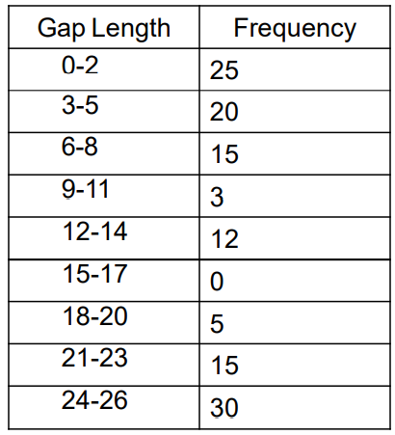
Tests for Randomness - Uniformity and independence
Test for independence :Gap Test
2. Based on the frequency with which gaps occur, analyze the digits below to test whether they are independent. Use α = 0.05.

Slide 82
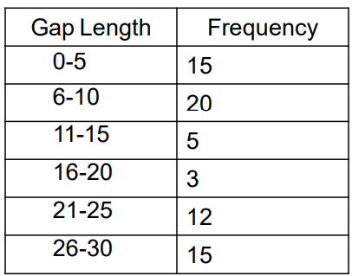
Tests for Randomness - Uniformity and independence
Test for independence :Gap Test
3. Based on the frequency with which gaps occur, analyze the digits below to test whether they are independent. Use α = 0.05.

Slide 83
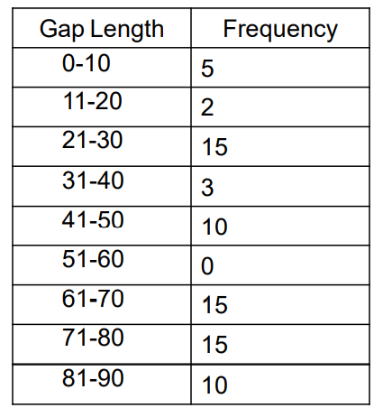
Tests for Randomness - Uniformity and independence
Test for independence :Gap Test
4. Based on the frequency with which gaps occur, analyze the digits below to test whether they are independent. Use α = 0.05.

Slide 84
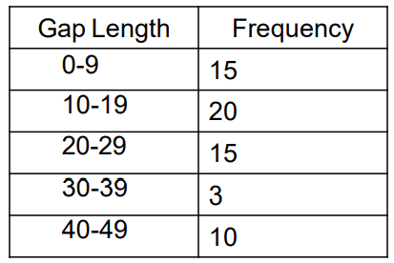
Tests for Randomness - Uniformity and independence
Test for independence :Gap Test
5. Based on the frequency with which gaps occur, analyze the digits below to test whether they are independent. Use α = 0.05.

Slide 85
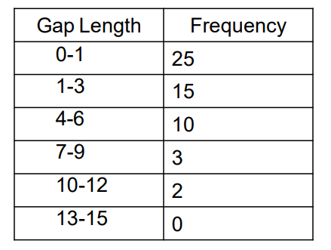
Tests for Randomness - Uniformity and independence
Test for independence :Gap Test
6. Based on the frequency with which gaps occur, analyze the digits below to test whether they are independent. Use α = 0.05.

Slide 86
Random Variate Generation
Non Uniform Random Number Generation/Random Variate generation:
A random variate is a particular outcome of a random variable.
a random variable is a measurable mapping, and a random variate is just a member of the codomain of a random variable.
A random variable or stochastic variable is a variable whose value is subject to variations due to chance
A random variate is a particular outcome of a random variable: the random variates which are other outcomes of the same random variable would have different values
Suppose X is a random variable which stands for the outcome of tossing a fair dice. So X can take value from 1 through 6 with equal probability of 1/6. Now you actually toss a dice and get a number 4. This number is a particular outcome of X, and thus a random variate. If you toss again, you may get another different value.

Slide 87
Random Variate Generation
Non Uniform Transformation Method /Inverse Transform Method:
The inverse transform technique can be used to sample from the exponential, uniform, triangular distribution etc. by inversing the CDF of those probability distributions. The inverse transform technique can be utilized for any distribution when the cdf, F(x), is of a form that its inverse, F⁻¹ can be computed easily.

Slide 88
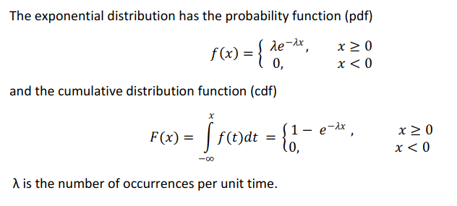
Random Variate Generation
Non Uniform Transformation Method /Inverse Transform Method:
Exponential Distribution

Slide 89
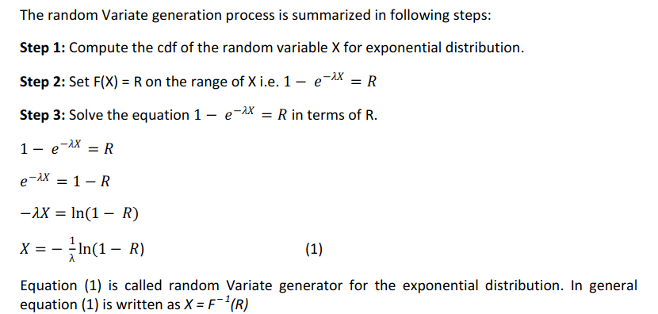
Random Variate Generation
Exponential Distribution

Slide 90
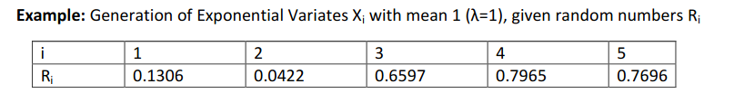
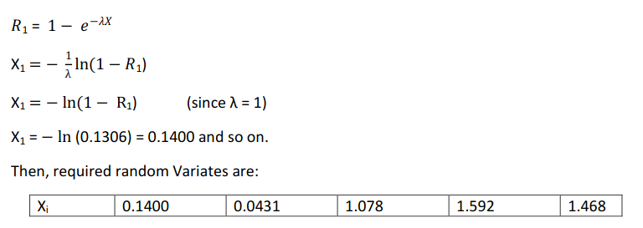
Random Variate Generation
Non Uniform Transformation Method /Inverse Transform Method:
Exponential Distribution

